Slide 2
Meet the Team
CEO
Tariq Islam
VP
Nathaniel Tucek
Executive Assistant
Paige Blomberg
CMO
Nicholas Meyer
COO
Joel Lange
CFO
Dylan Riess
CSO
Matthew Luke

Slide 3
Mission Statement
“RiverBend Retailers strives to create a lasting impression within the residents of Mankato. We believe in putting smiles on the faces of the people within our community through providing quality products that represent their pride of being a part of the Minnesota culture”

Slide 5
Products
Flags
3ft x 5ft
Printed directly to material – high resolution
Grommet for ease of use

Slide 6
Products
Hand Crafted Wooden Wall Signs
Size: 16 in x 16 in
Material: Oak
Stain: Dark Walnut
Production: Hand crafted by supplier

Slide 7
SWOT Analysis
Strengths | Weaknesses
Mankato based company selling to a customer base that is local and familiar with the University Large customer base within the University Affordable and variety of products for our customers Unsaturated market | Lack of experience Limited to build our brand Limited time to properly research our customer base Season makes it difficult to market or sell our products outside Part time employees
Opportunities | Threats
Network and establish effective relationships with local businesses Large target market for our products Recent college culture Previous successful market venture | Competing with Scheels, Kohl’s and the campus bookstore No real necessity of this product to a customer; purely decorative purpose

Slide 8
Marketing
DEPARTMENT LAYOUT
RESPONSIBILITIES
Nicholas Meyer (CMO)
Kalli Steinberg
Sambridi Pradhan
Chase Koch
Kaitlin Ameluxen
Community Based Promotion
Social Media
Branding & Advertisement
Market Research

Slide 9
Marketing Objectives
Reach 25,000 individuals for our company social media campaign
Table at least 15 events throughout the 8-week sales period
Connect with non-profits to further increase our target market and expand our brand name

Slide 10
Marketing Research
Surveys
Created surveys online at Qualtrics and collected data via Google Analytics & Google Trends
Distributed the surveys via:
Facebook
Twitter
E-mail
LinkedIn
First survey received 485 responses

Slide 11
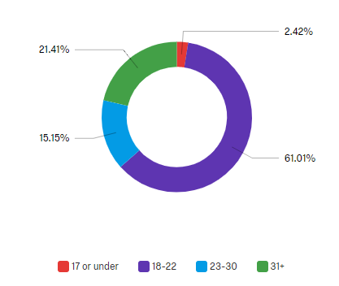
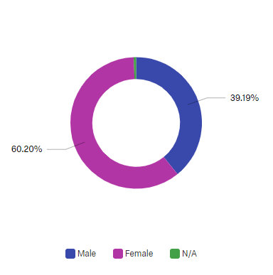
Demographics
Age
Gender

Slide 12
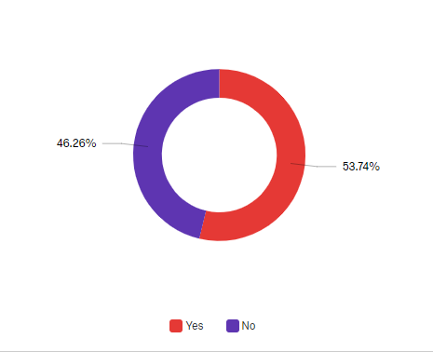
Relation to MNSU

Slide 13
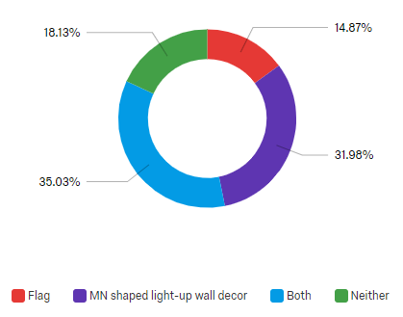
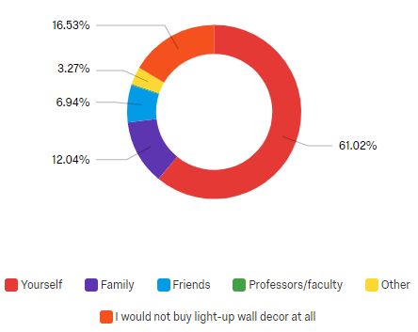
Marketing Research
Consumer Interests
The first graph shows the consumer interest for our products.
The second shows who our consumers would buy the product for.

Slide 14
Marketing Research
Data Analysis
Our data analysis shows 81.83% responding that they would buy one if not both of the products.

Slide 16
Who are we selling to?
Target Market: Flags
Target Market: Wooden Sign
Primary market
Younger adults
People aged 18-22 (61.01%)
Secondary market
MSU Alumni & Faculty
Primary market
Mid to high income
People in and around the Greater Mankato Area.
Faculty and alumni
Age 30 and up
Secondary market
Young adults ages 18 - 25

Slide 17
Marketing Research
By analyzing the data we have concluded the following prices
Flag : $20
Wooden Sign: $50

Slide 18
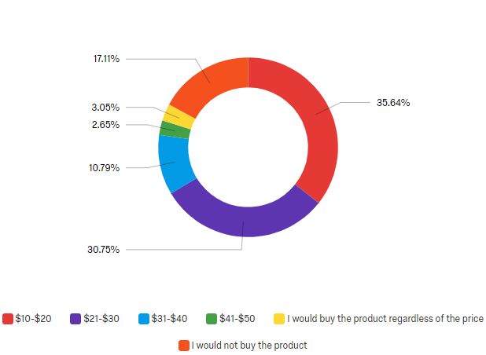
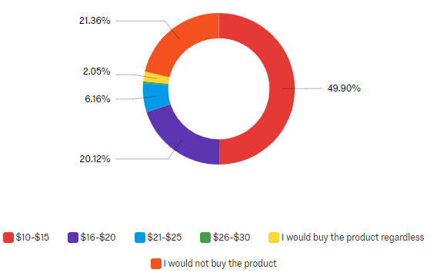
Marketing Research
Price Evaluation
First, wooden wall sign price data graph.
Second, Flag price data graph.

Slide 19
Promotional Strategy
Social media
LinkedIn, Instagram & Facebook
Strong social media campaign
Publicity
MNSU Reporter
Charity promotion
Radio ads
Flyers & Posters around campus
$100 campus printing service allowance

Slide 20
Promotional Plan
 | Week 1 | Week 2 | Week 3 | Week 4 | Week 5 | Week 6 | Week 7 | Week 8 | Total
Social Media | 6 Posts on both Facebook and Instagram | 2 Posts on both Facebook and Instagram | 2 Posts on both Facebook and Instagram | 2 Posts on both Facebook and Instagram | 2 Posts on both Facebook and Instagram | 2 Posts on both Facebook and Instagram | 2 Posts on both Facebook and Instagram | 2 Posts on both Facebook and Instagram | 20
Promotion | 1 Tabling event in CSU | 2 Tabling events in CSU | 2 Tabling events in CSU | 2 Tabling events in CSU | 2 Tabling events in CSU | 2 Tabling events in CSU | 2 Tabling events in CSU | 2 Tabling events in CSU | 15
P.R Community based marketing | 1 event at the boys and girls club | 1 church presentation | 1 church presentation | 1 church presentation | 1 church presentation | 1 church presentation | 1 church presentation | 1 church presentation | 8

Slide 21
The Competition
Advantages
Brand recognition
Convenient location
Disadvantages
High prices
Wooden Signs
Advantages
Easy to make purchases
Low Prices
Disadvantages
Shipping time
Not Local
No customized Mankato Flags

Slide 22
Sales
Department Layout
Responsibilities
Matthew Luke (CSO)
Carter Burroughs
Kallie Miller
Peter Crema
Dalton KEUP
Coordinate and schedule tabling and other sales opportunities
Coordinate work schedules for company employees
Assist marketing in planning process

Slide 23
How We’ll Sell
How?
Where?
When?

Slide 24
Cash Management
Sales will be logged on paper and Microsoft Excel
Cash goes to finance and sales will send their numbers to finance and operations
Finance will bring the cash to the bank

Slide 25
Operations
Committee Members
Responsibilities
JOEL LANGE (COO)
TAYA SEXTON
PAIGE BLOMBERG
Maria Lamere
Andrew Rowe
Order product
Distribute inventory
Reconcile inventory and transactions

Slide 26
Storage
Location
Access
Vacant office within the CIE in downtown Mankato
IBE Kiosk in Morris Hall
Joel and Taya will share a key to the vacant office. Dr. Yvonne Cariveau, the director of the CIE, will have a key to the office as well​
Nathaniel and Joel will have the code for the lock of the kiosk​

Slide 27
Shipping
From Suppliers
To Customers
Costs of shipping for flags: $250
No shipping cost for signs as we will be able to pick them up locally
Shipping to customers will be a case-by-case basis. Customers are responsible for all shipping costs.
Product will be delivered to the customer, or we will coordinate a safe place to meet.

Slide 28
Inventory
Kato Flag
Minnesota Sign
First order: 250
Kato designs were favored by the people we surveyed.
First order: 40
Our data showed a preference for wall signs.

Slide 29
Product Prices
Kato Flag
Minnesota Sign
$2.50 per flag
Sales Price: $20
$250 for shipping
Markup: 472%
$20 per sign
Sales Price: $50
Markup: 150%

Slide 30
Selling/Return Policies
Items sold will be tracked with a receipt spreadsheet on Excel.
Any items taken from storage by a company member, will be checked out on our inventory log.
All our products will be inspected upon arrival so that no defective products will be sold.
We will issue no returns, or exchanges. All sales are final.

Slide 31
Finance
Department Layout
Responsibilities
Dylan Riess (CFO)
Chris Infanzon
Brandon Bailey
Kami Ochsendorf
Prepare financial statements
Monitor financial status
Ensure company is profitable
Keep cash logs

Slide 32
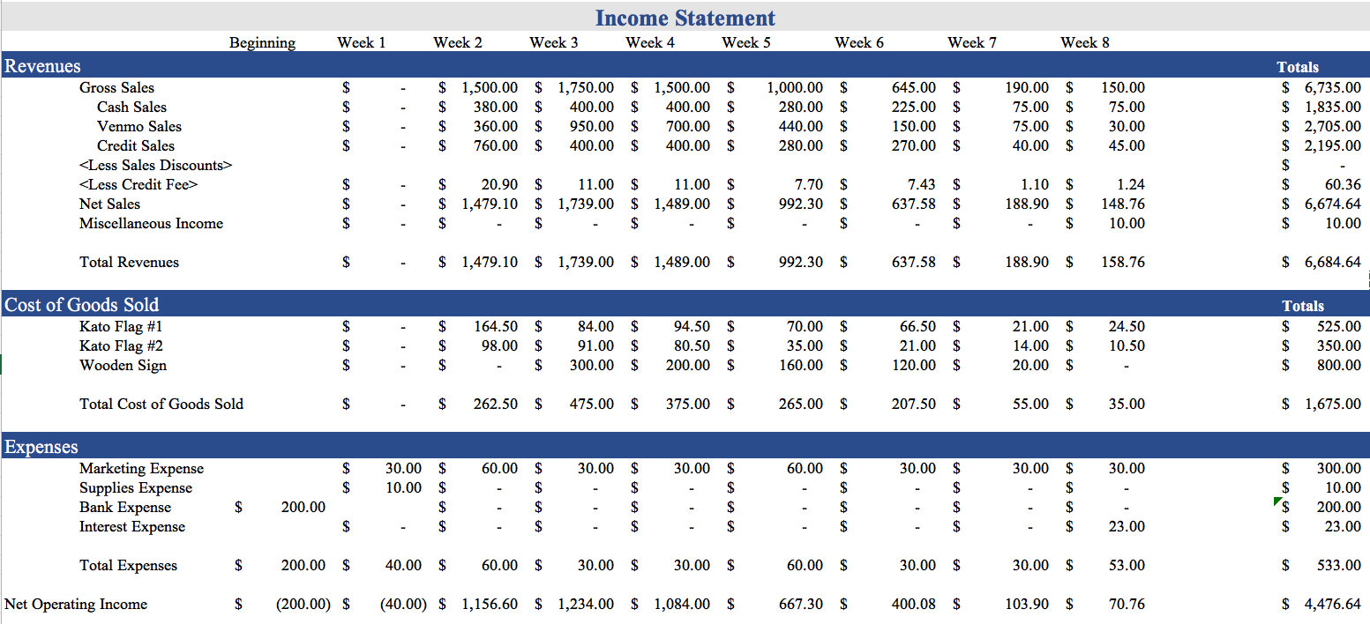
Revenue Forecast

Slide 33
Net Income
Best Case
Net Sales | $6,961.60
Cost of Goods Sold | $1,675.00
Expenses | $533.00
Net Income | $4,753.60
Expected Case
Net Sales | $6,684.64
Cost of Goods Sold | $1,675.00
Expenses | $533.00
Net Income | $4,476.64
Worst Case
Net Sales | $6,482.36
Cost of Goods Sold | $1,675.00
Expenses | $533.00
Net Income | $4,274.36

Slide 34
Breakeven Analysis
Debt Service Coverage Ratio
Net Operating Income / Loan + Interest
$4,476.64 / ($2,300.00 + $23.00) = 1.9271
Product | Variable Cost Per Unit | Fixed Cost Per Unit | Cost Per Unit | Quantity | Selling Price | Sales Needed to Break Even | Gross Margin
Flags | $3.50 | $1.02 | $4.52 | 250 | $20 | 57 | $3,870.00
Wooden Sign | $20.00 | $6.38 | $26.38 | 40 | $50 | 23 | $745.00

Slide 35
Loan Request
Total Loan: $2,300
Breakdown:
Products $1,675
Supplies $10
Loan Fees $200
Marketing Budget $300
Cash Buffer $115

Slide 36
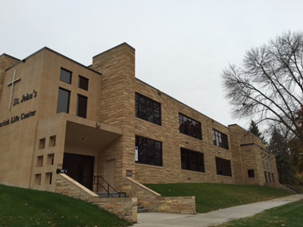
Donations
Boys and Girls Club of Mankato
The mission of Boys & Girls Club is to empower all young people, especially those who need us most, to realize their full potential as productive, responsible and caring community members. Vision: To give every child access to a safe, nurturing, educational environment, that positively impacts their lives.

Slide 37
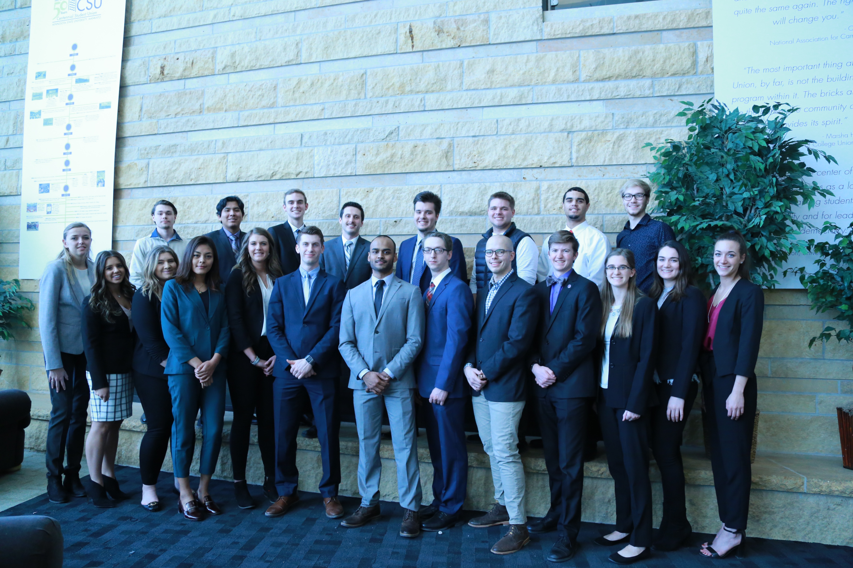

Slide 38
QUESTIONS?

Slide 39
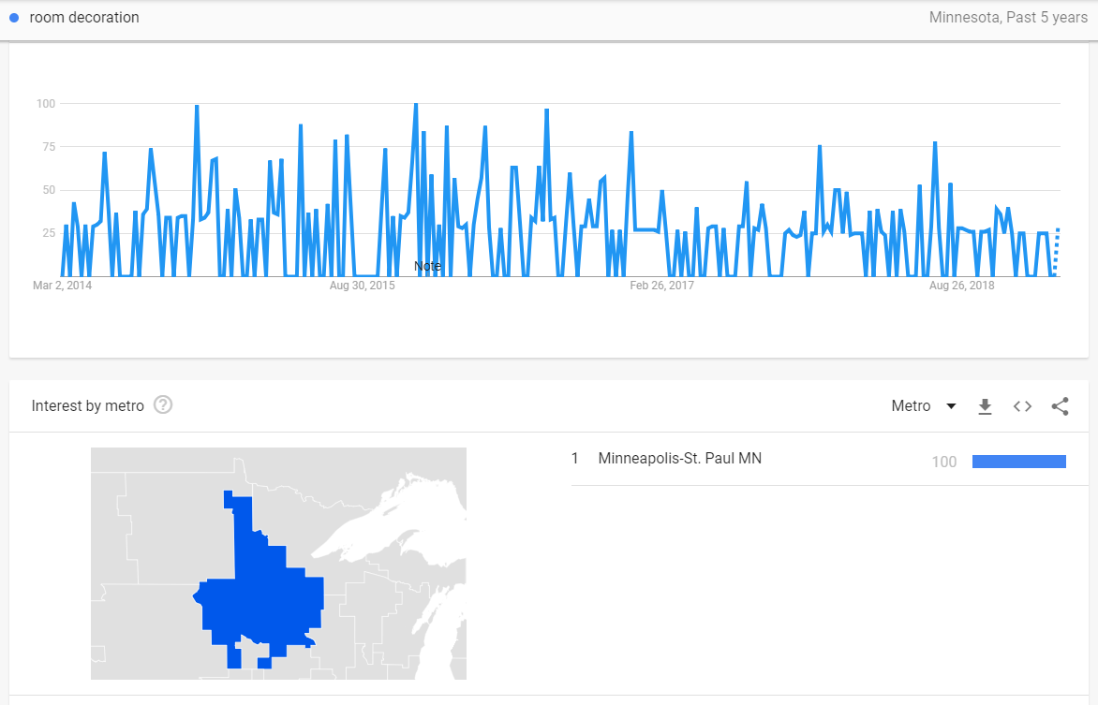

Slide 40
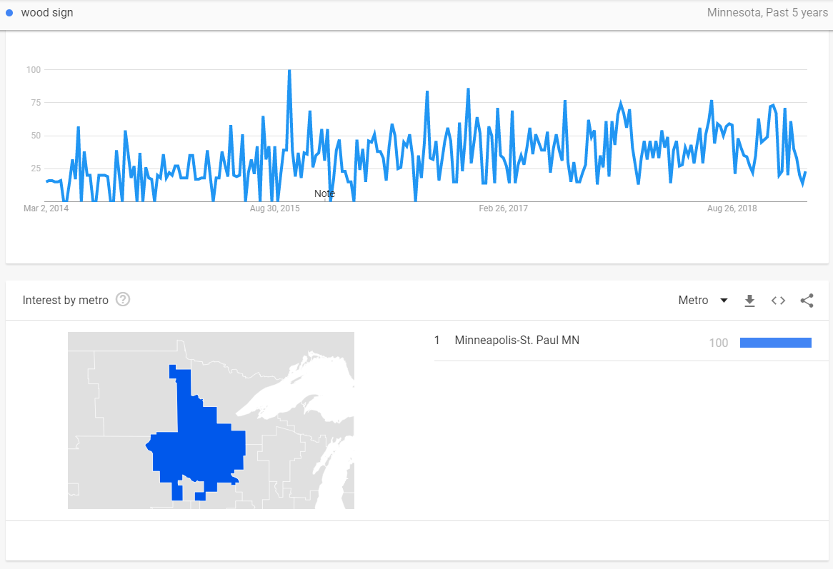

Slide 41
